Slide 1
Automated Food Serving Robot for Restaurants
Guide Batch No-A2
Dr. M. Vijayalakshmi 22255A0401- G. ShivaTejaswini
Assoc. Professor, ECE 21251A0455 - S. Sujitha 21251A0421 - N. Haripriya 21251A0450 - P. Sathwika

Slide 2
CONTENTS
1. Aim
2. Objectives
3. Introduction
4. Literature Survey
5. Existing System
6. Block Diagram
7. Circuit Diagram
8. Results
9. Advantages
10. Conclusion
11. References

Slide 3
AIM
1. To Develop an automated food-serving train system to transport food items from the kitchen to designated serving points.
2. Incorporate Hall Effect sensors for precise reference point identification and automated operation.

Slide 4
OBJECTIVES
To Complete Literature Survey
To design an automated robot for delivering food to tables in restaurants using 89C51 MC and RF Transmitter and Receiver.
To incorporate RF-based wireless control for the robot’s navigation and a voice recorder and playback chip.
To Design a remote control unit using 89C2051 microcontroller.
To complete Documentation and Paper Publication.

Slide 5
INTRODUCTION
The restaurant industry is rapidly evolving with the integration of automation and robotics, particularly through the introduction of food-serving robots.
Food-serving robots are shaping the future of the dining experience.
Food-serving robots improve service speed, accuracy, and consistency.

Slide 6
LITERATURE SURVEY
A case study by Harms (2021) demonstrated that automated serving systems significantly improve service delivery, allowing restaurants to serve more customers effectively while maintaining quality.
According to Kuo & Yang (2020), the implementation of robotics in food service increases both speed and consistency, as robots can quickly fulfill orders without the variations often associated with human staff.
Despite the advantages, the high initial investment costs of robotic systems and the need for staff to adapt to new technology present significant barriers to widespread adoption in the restaurant sector.
Consumers are showing an increasing willingness to embrace robotics in their dining experiences, valuing the convenience and novelty that these technologies bring, as highlighted by the National Restaurant Association (2024).

Slide 7
COMPARISIONS
S.NO | PREVIOUS MODEL | PRESENT MODEL
1 | Line follower | Track follower
2 | DC motors | High torque DC motors
3 | MQTT not supported | RF signals(443Mhz)
4 | Food carrying capacity upto 1kg | Food carrying capacity upto 3kg
5 | Manual operation | Remote controlled operation
6 | Less stability | High stability
7 | Plastic wheels | Metal wheels

Slide 8
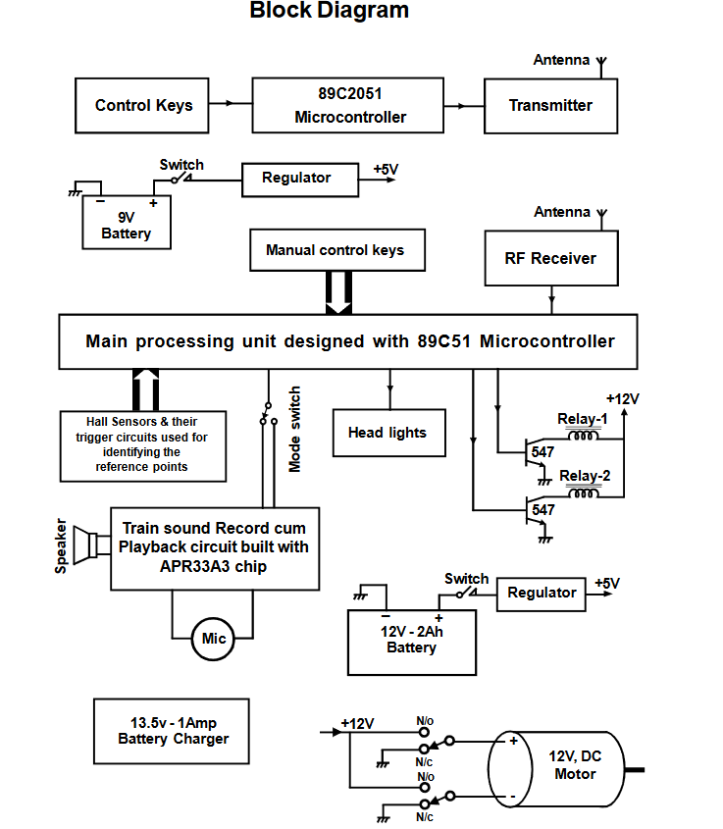

Slide 9
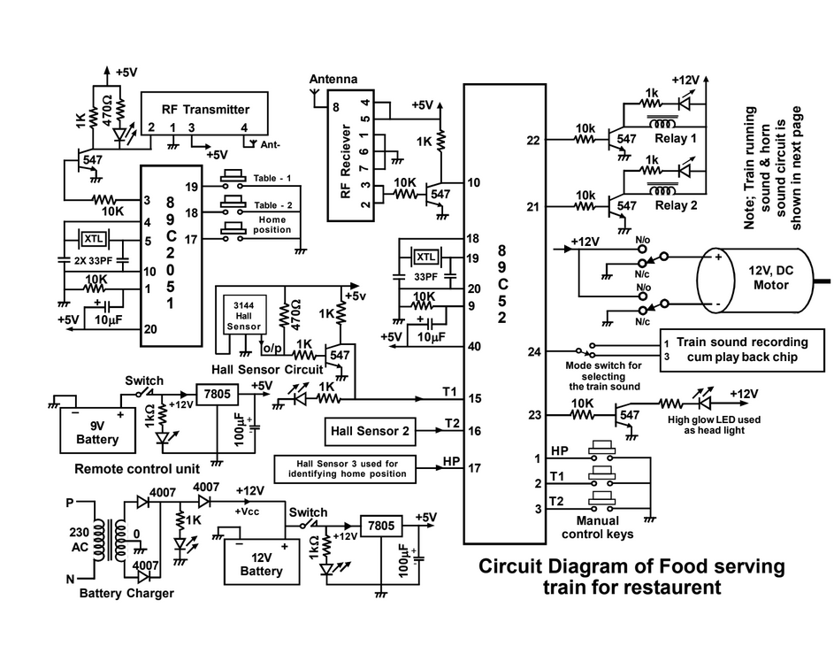

Slide 10
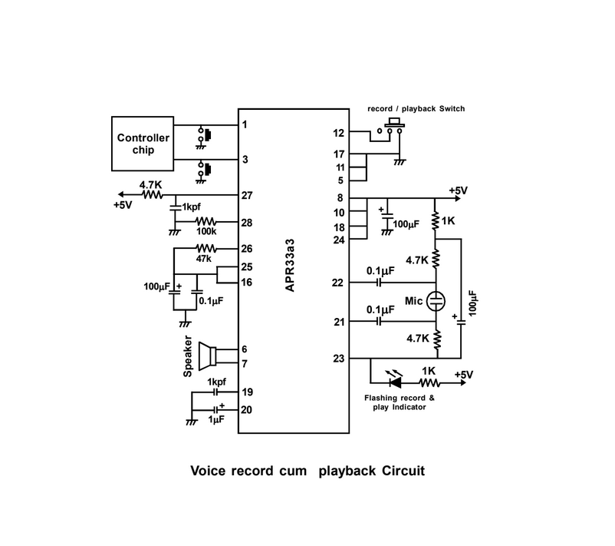

Slide 11
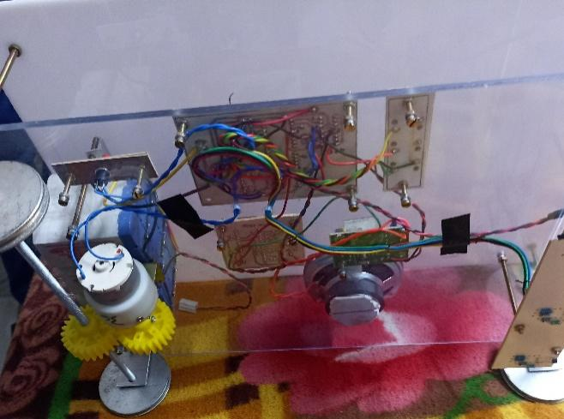
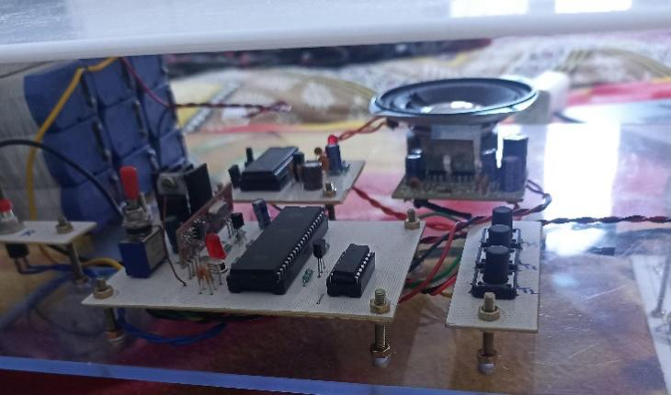
RESULTS
Fig.1 Mechanical Structure
Fig.2 Microcontroller-based control circuit

Slide 12
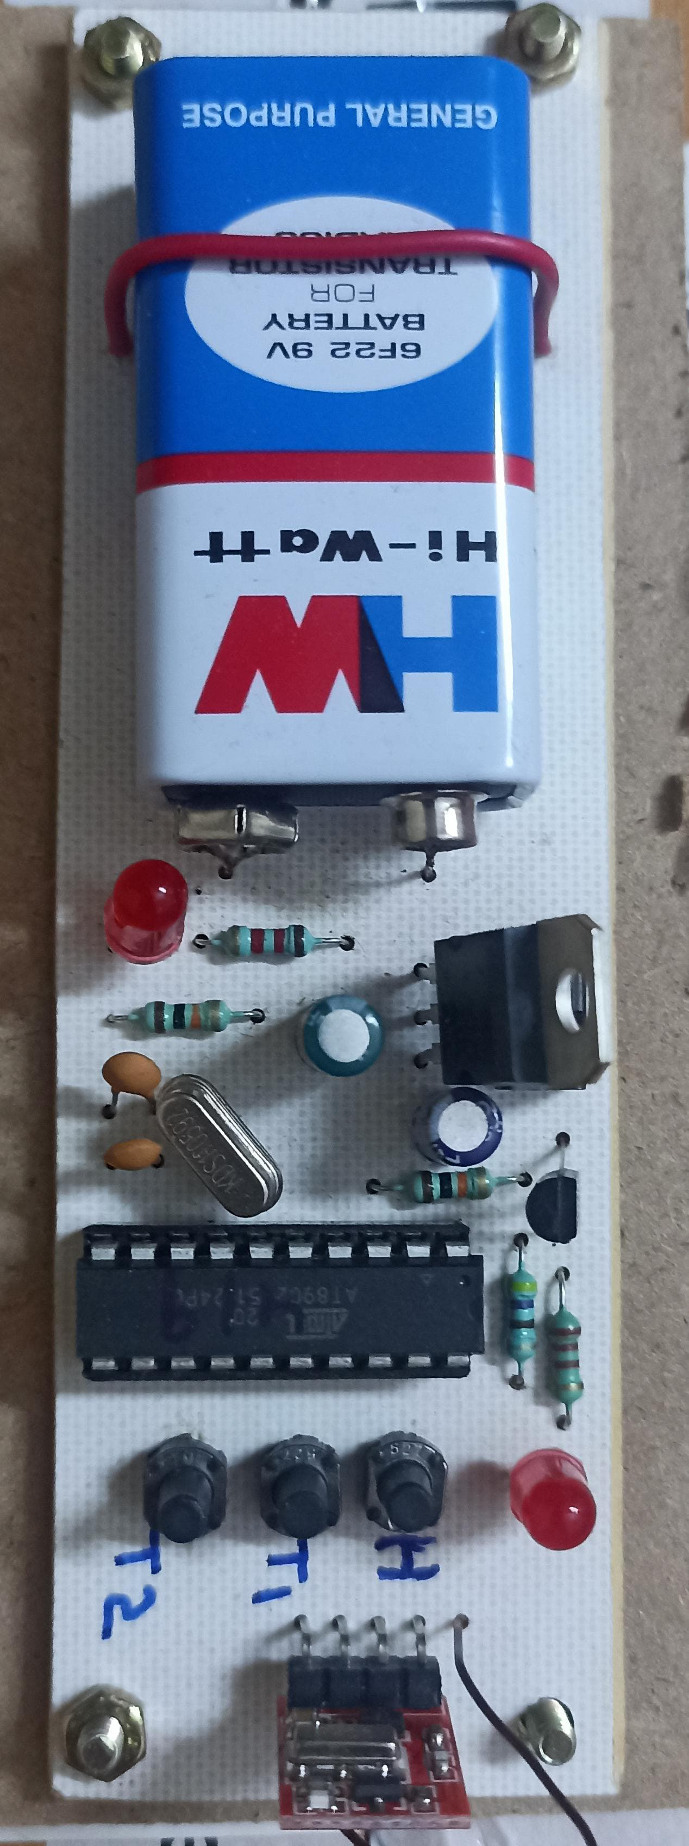
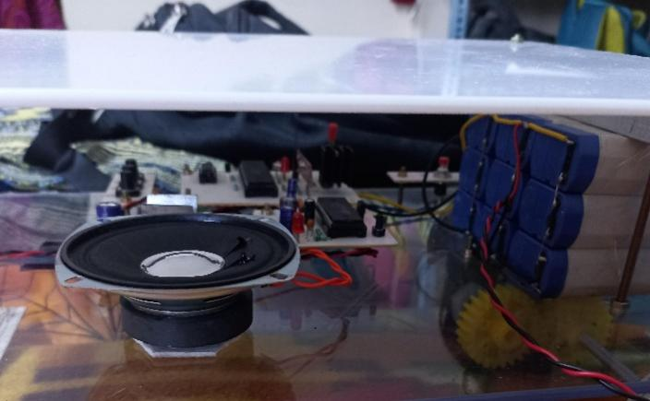
Fig.3 Power Supply and Audio Output System of the Automated Robot
Fig.4 Remote Controller

Slide 13
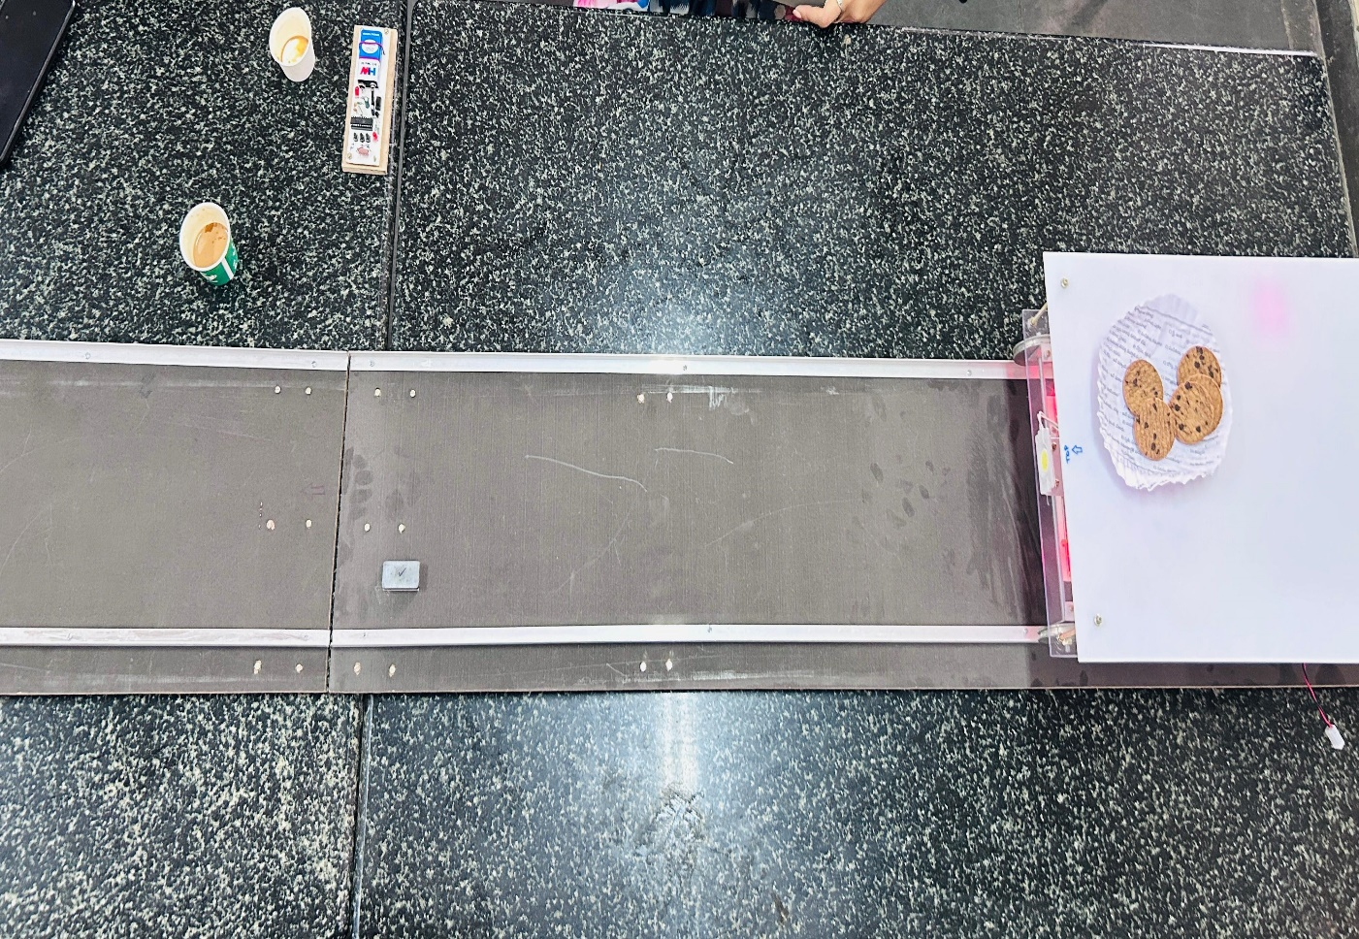
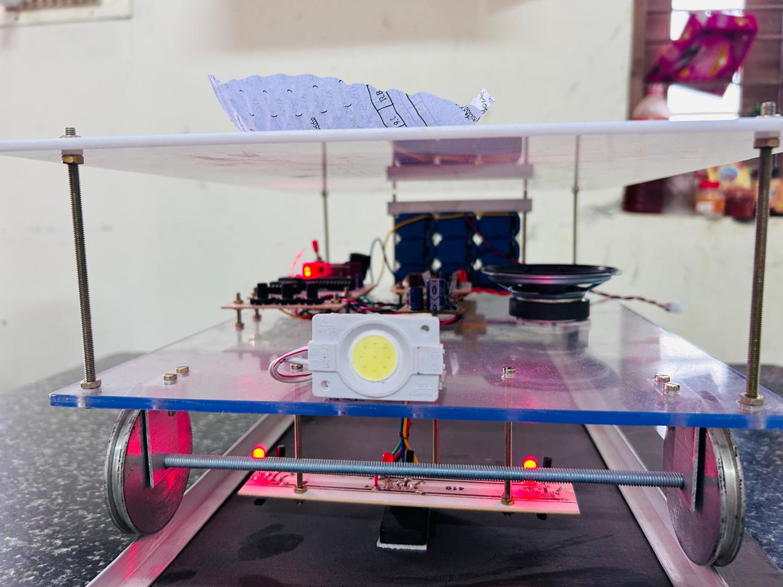
Fig.5 Top View of the Automated delivery system on a Conveyor Track
Fig.6 Smart Conveyor-Based Delivery Robot

Slide 14
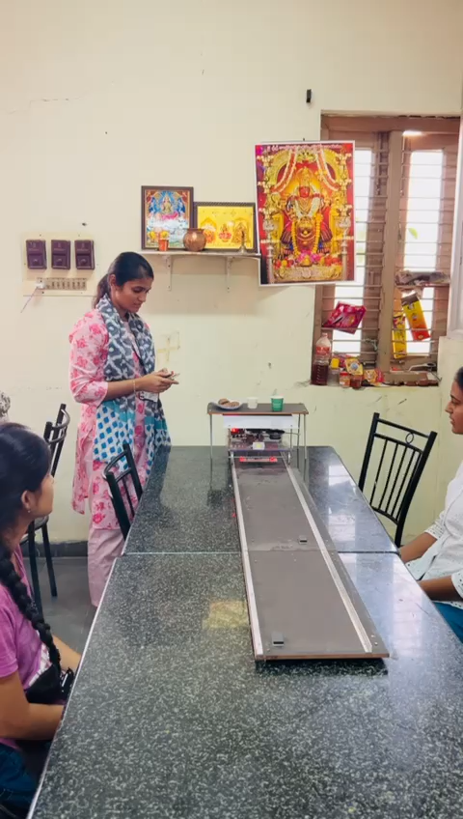
Operation of the Automated Delivery system in motion

Slide 15
ADVANTAGES
Enhanced efficiency by increasing the speed of service, reducing customer wait times, and improving overall satisfaction.
Consistent quality and accuracy in order fulfillment, minimizing human error and ensuring reliable dining experiences.
Cost savings through reduced labor expenses, as robots can operate continuously without breaks or overtime.

Slide 16
CONCLUSION
The Automated Food Serving Robot enhances restaurant efficiency by autonomously delivering food using obstacle-avoidance sensors and precise navigation.
The integration of microcontrollers, RF communication, and IoT ensures seamless order management and interaction.
This system improves service speed, reduces human effort, and ensures reliable performance in a dynamic restaurant environment.

Slide 17
REFERENCES
[1]Kim and H. Lee, "Automation in Restaurant Operations: A Review," Journal of Hospitality and Tourism Technology, vol. 10, no. 3, pp. 341-357, 2019.
[2] C. Kuo and C. Yang, "The Role of Robotics in Food Service: Opportunities and Challenges," International Journal of Hospitality Management, vol. 88, p. 102385, 2020.
[3] B. M. Kachru, Restaurant Management: A Strategic Approach, New Delhi: Pearson Education, 2017.
[4] R. J. Kwortnik, Service Operations Management: The Total Experience, New York: McGraw-Hill, 2020.
[5] Technavio, "Global Restaurant Automation Market 2022-2026." [Online]. Available: https://www.technavio.com. [Accessed: Nov. 1, 2024].

Slide 18
[6] IBISWorld, "Fast Casual Restaurants in the US - Market Research Report." [Online]. Available: https://www.ibisworld.com. [Accessed: Nov. 1, 2024].
[7] National Restaurant Association, "Restaurant Trends in Technology." [Online]. Available: https://www.restaurant.org. [Accessed: Nov. 1, 2024].
[8] Robotics Business Review, "How Robots are Transforming the Restaurant Industry." [Online]. Available: https://www.roboticsbusinessreview.com. [Accessed: Nov. 1, 2024].
[9] J. Harms, "Implementation of Robotics in Food Service: A Case Study of Automated Serving Systems," Journal of Foodservice Business Research, vol. 24, no. 1, pp. 43-58, 2021.
[10] Y. Xu and Y. Tan, "Robotics in the Food Industry: A Comprehensive Review," Food Engineering Reviews, vol. 13, no. 1, pp. 33-54, 2021.

Slide 19
Thank You

